Slide 1


An AI Framework for Linear B Translation into Ancient Greek and English
Tutti i diritti relativi al presente materiale didattico ed al suo contenuto sono riservati a Sapienza e ai suoi autori (o docenti che lo hanno prodotto). È consentito l'uso personale dello stesso da parte dello studente a fini di studio. Ne è vietata nel modo più assoluto la diffusione, duplicazione, cessione, trasmissione, distribuzione a terzi o al pubblico pena le sanzioni applicabili per legge
Notes:
‹#›

Slide 2
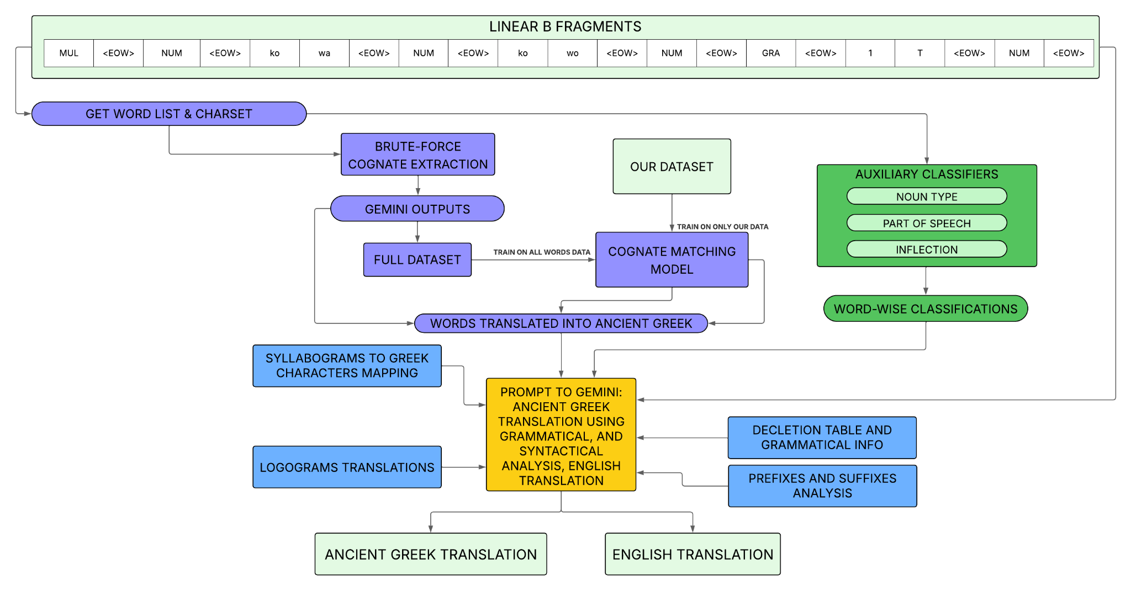
AI Framework for Linear B translation: overview
This presentation covers the following topics:
What Linear scripts are and their data sources
Cognate matching task between Linear B and Ancient Greek
Auxiliary information gathering to perform translation
A translation pipeline for Linear B automated translation into Ancient Greek and English
An AI Framework for Linear B translation into Ancient Greek and English
Page 2
Notes:
prova

Slide 3
Aegean Linear Scripts: web scraping
Cretan Hieroglyphic (2100 - 1700 B.C.)
Linear A (1900 - 1450 B.C.)
Linear B (1400 - 1200 B.C.)
https://sigla.phis.me/
https://liber.cnr.it/
774 full documents collected
Document level information
Sequence level information
Sign level information
5638 full documents collected
Signs preprocessing and normalization
Document name
Link
Chronology
Findspot
Size, support, motif (LA)
Scribe, palmprint, museum inventory number (LB)
Sequence
Length
Complete
Findspot
Sequence number
Sign
Function (LA)
Sign number
An AI Framework for Linear B translation into Ancient Greek and English
Page 3
Notes:
‹#›

Slide 4
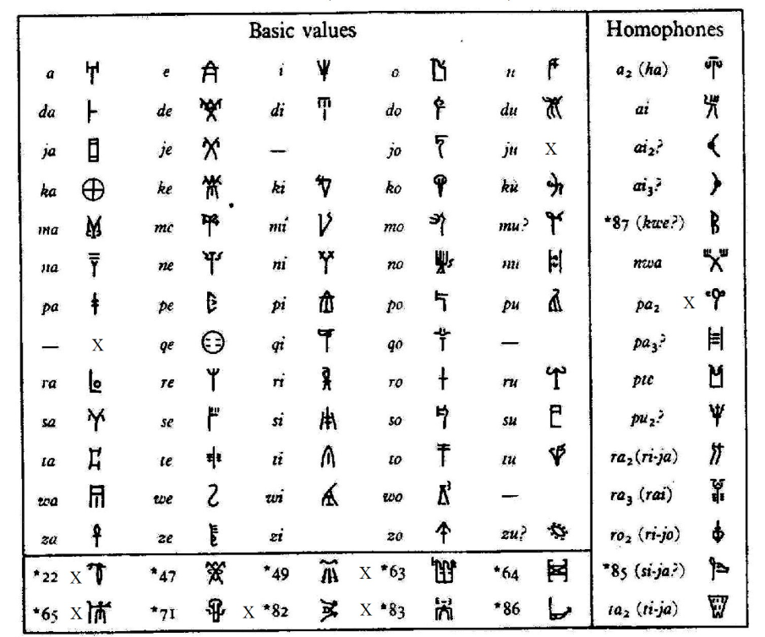
Linear B: the script
Linear B script is logosyllabic:
logograms are symbols that stand for entire words
syllabograms are symbols representing phonetic syllables
Deciphered by Michael Ventris in 1952
70% of syllabograms shared with Linear A
Used to write Ancient Greek
An AI Framework for Linear B translation into Ancient Greek and English
Page 4
Notes:
‹#›

Slide 5
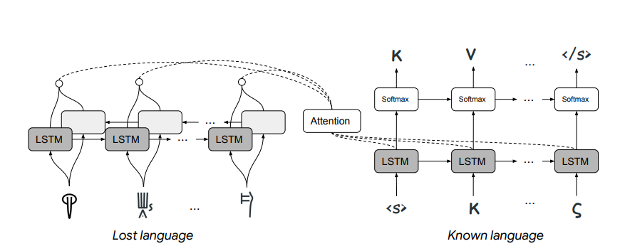
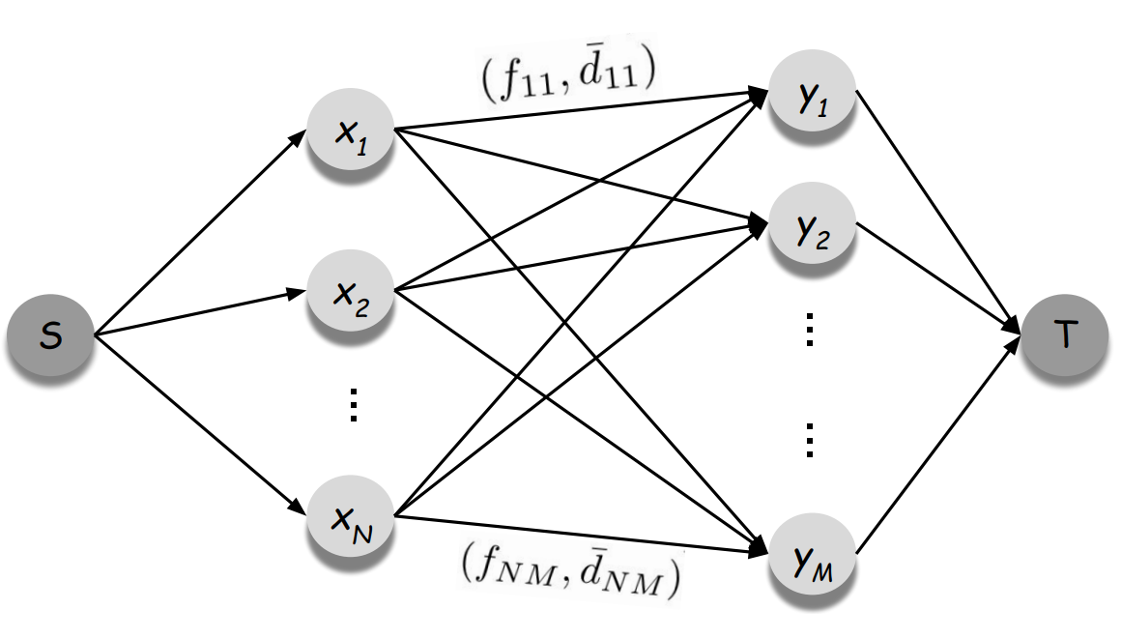
Cognate matching
Being Linear B and Ancient Greek the same language with a different scripts, we can map their cognates.
Jiaming Luo’s Cognate Matching Framework was employed.
Generative model: produces an Ancient Greek cognate for any Linear B word.
Expectation-Maximization training
Network-flow problem for cognate matching.
Cognates examples:
ko-no-so → Κνωσός
ko-wo → κόρος
do-se → δώσει
Estimate Edit distance
An AI Framework for Linear B translation into Ancient Greek and English
Page 5

Slide 6


Cognate Matching Model
Jiaming Luo outlined four language-agnostic cognate matching principles:
Distributional similarity of matching characters
Monotonic character mapping within cognates
Structural sparsity of cognate mapping
Significant cognate overlap within related languages
His model architecture deals with all these principles.
The machine learning model is responsible for the first two properties,
the flow latent variable (F) accounts for the other two.
An AI Framework for Linear B translation into Ancient Greek and English
Page 6

Slide 7
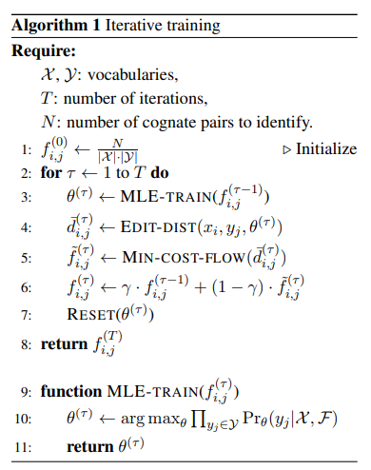
Training Technique
Progressively updates latent flow values, used for loss computation
Reinitialize the model at each E-step
3 output modes: MLE, Flow, and Flow with Expected Edits
Distances gathered from multiple sampling + edit distance, or from character-wise probabilities product
Flow Mode output: output of min-cost flow computed with the trained model
An AI Framework for Linear B translation into Ancient Greek and English
Page 7

Slide 8
Dataset making
The Linear B cognate matching dataset employed was updated.
The dataset making comprised:
Manual corrections to Luo’s original dataset
Brute-force greedy algorithm to associate Linear B words to possible Ancient Greek cognates from Homer (Iliad and Odyssey)
Cognates refinement through structured prompt engineering
Manual corrections
Adding other matches from Tselentis lexicon (available only as a PDF, processed with OCR tools and manually revised).
Luo’s original dataset: 919 Linear B words, 1418 Greek correspondences
Our dataset: 1911 Linear B words, 2383 Greek correspondences
An AI Framework for Linear B translation into Ancient Greek and English
Page 8

Slide 9
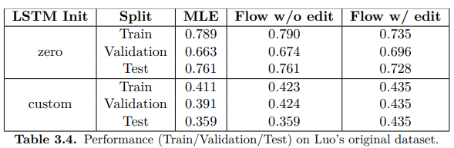
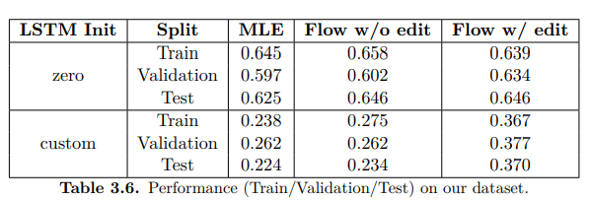
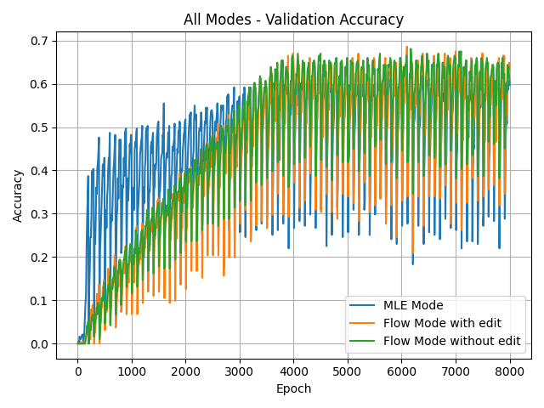
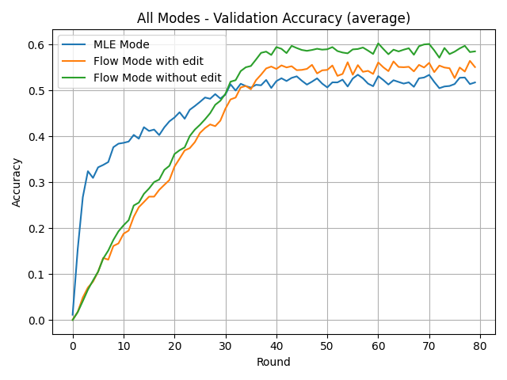
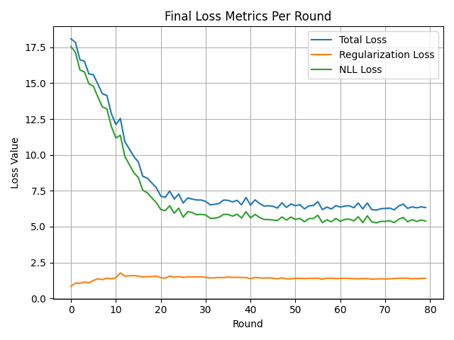
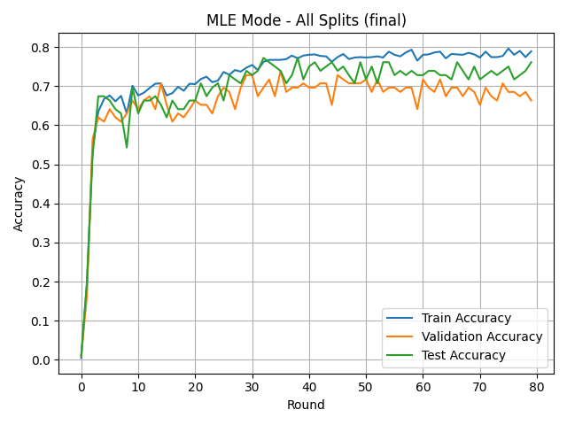
Cognate matching results
An AI Framework for Linear B translation into Ancient Greek and English
Page 9

Slide 10
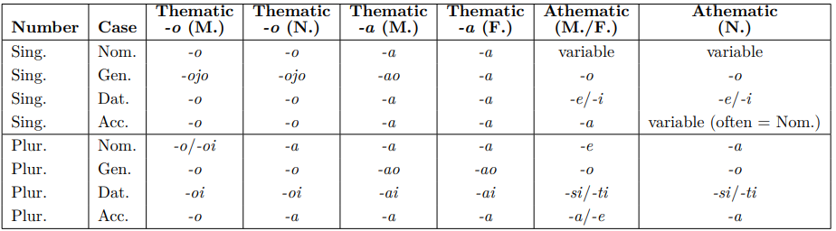
Auxiliary classifiers
Three additional tasks were identified to support translation:
Part of Speech Detection: noun, adjective, verb, adverb
Noun type: proper, toponym, ethnonym, common
Inflection Detection: thematic -o, thematic -a, athematic
POS Detection: clarifies words’ role in the sentence.
NT: clarifies how nouns (and adjectives) should be interpreted
ID: explains how to interpret inflected terms thanks to declension table
An AI Framework for Linear B translation into Ancient Greek and English
Page 10

Slide 11
Tested solutions
The first approach: training neural networks (BRNN, convolutional) on embedded tokenized Linear B words.
This approach demonstrated slow convergence and low performance.
The second approach: bag-of-words for the Linear B syllabograms and Tf-Idf features for n-grams.
This word preprocessing proved to be effective for all tasks, with a variety of models while also being much more efficient.
Due to the more satisfactory results, only this approach was tested using 5-fold Cross Validation with the following models:
Logistic Regression
Random Forest
Linear SVM
Multinomial Naive Bayes
Histogram-based Gradient Boosting Classification Tree
MLP classifier
An AI Framework for Linear B translation into Ancient Greek and English
Page 11

Slide 12
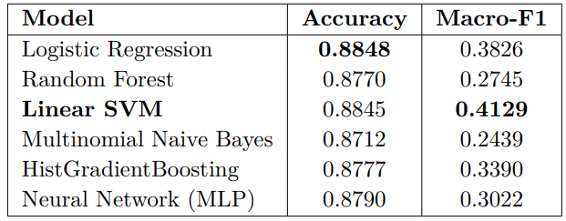
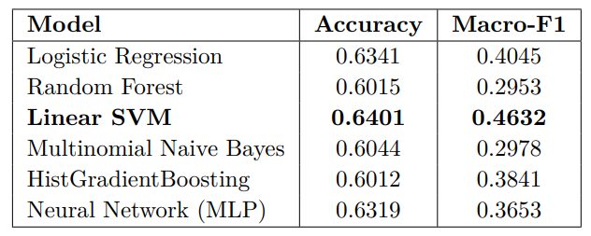
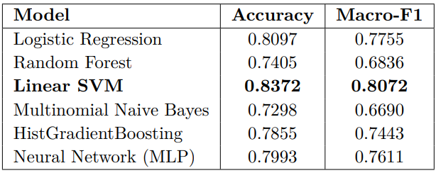
Auxiliary tasks results: Linear SVM performs best in all tasks
Part of Speech Detection
Noun Type Classification
Inflection Detection
An AI Framework for Linear B translation into Ancient Greek and English
Page 12

Slide 13
Translation Pipeline
An AI Framework for Linear B translation into Ancient Greek and English
Page 13

Slide 14
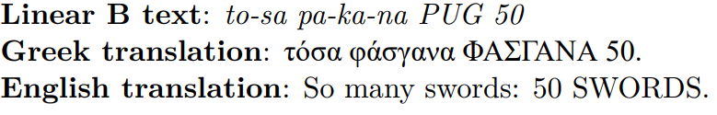
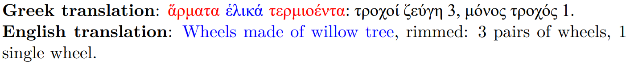
Results
12 documents, whose translation had been provided by Tselentis, have been manually evaluated.
Adjustments have been highlighted in red, mistakes in blue.
Document name: KN Ra 1540
Document name: KN So 4439
An AI Framework for Linear B translation into Ancient Greek and English
Page 14

Slide 15
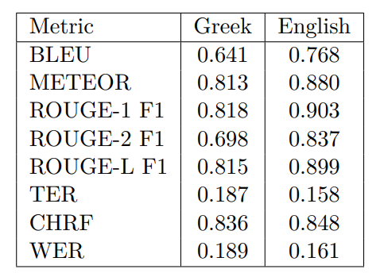
Error Analysis & Evaluation
Machine Translation metrics
Overall, four main causes of error were identified in the analyzed documents:
insufficient/misleading cognate information;
misinterpretation of words’ grammatical function (mostly due to wrong case selection);
auxiliary classifiers’ mislabeling, often turning common names into proper names;
Logograms misinterpretation, especially for abbreviations.
BLEU
METEOR
ROUGE-(1, 2 and L)
TER
CHRF
WER
An AI Framework for Linear B translation into Ancient Greek and English
Page 15

Slide 16
Conclusions and future work
Overall, the LLM always manages to understand the context of the administrative Linear B records, and translates most of them appropriately.
Possible ideas for future work include:
manual labeling of auxiliary classifiers’ dataset;
expanding auxiliary tasks (detecting tense/mood/voice for verbs, or case, gender and number for nouns/adjectives);
fine-tuning an LLM using expert-validated Ancient Greek and English translations;
forms normalization towards classical Ancient Greek;
add possible interpretations for logographic abbreviations;
evaluate the performance of this pipeline on other related languages.
extending the systematic evaluation to more documents from the Linear B corpus
An AI Framework for Linear B translation into Ancient Greek and English
Page 16

